Slide 1
Virtual Concierge
https://github.com/BrassM0nkeyy/virtual-concierge

Slide 2

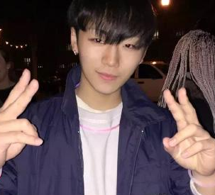



About Us
Eric Quan
Matthew Grech
https://www.linkedin.com/in/shengxu-quan1/
https://www.linkedin.com/in/matthew-grech-6b6a56162/
Notes:
short the link swap us

Slide 3
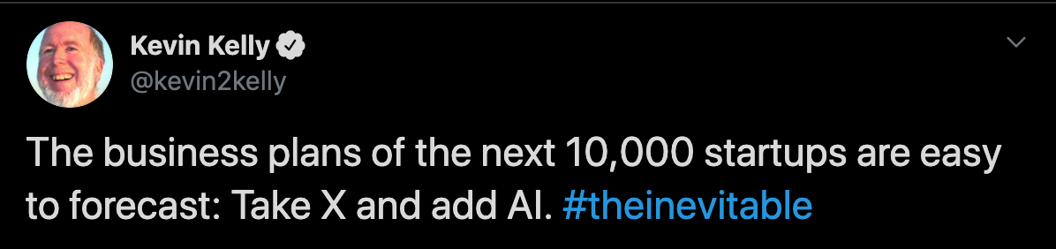
Making things smart
Notes:
what is vitrual concieger problem statement
introduce art school

Slide 4
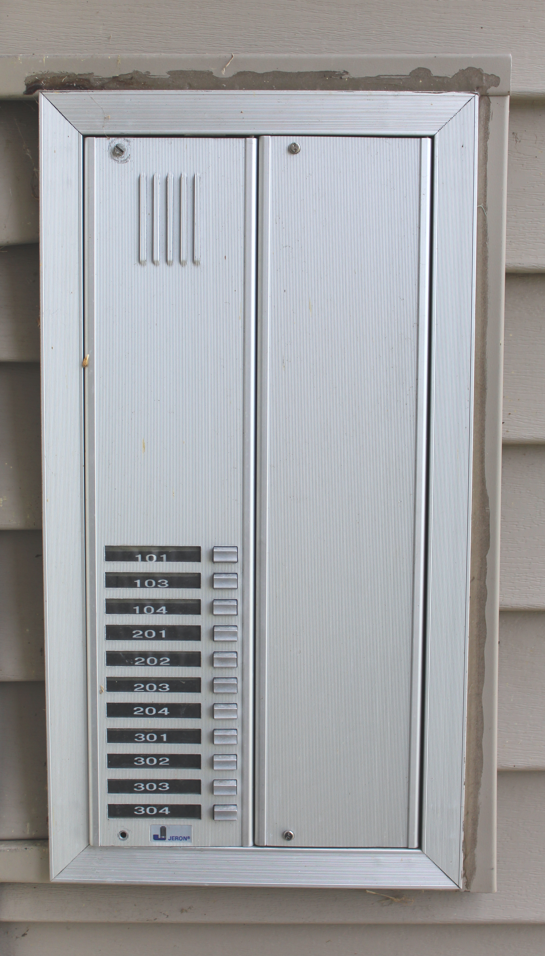
The Problem
Notes:
the problem we trying to solve

Slide 5



Slide 10
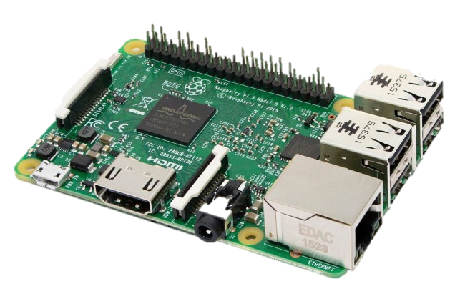

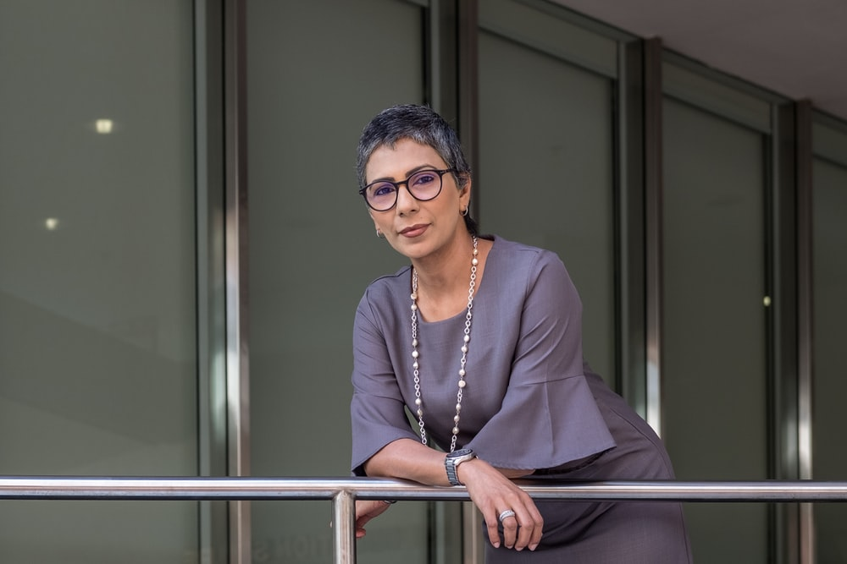


Demo Implementation
Notes:
demo

Slide 11

Uses
Similar implementation is being used for a local art school by our office
Notes:
solution

Slide 12
Tinkering
Opens door
Audio in/out

Slide 13
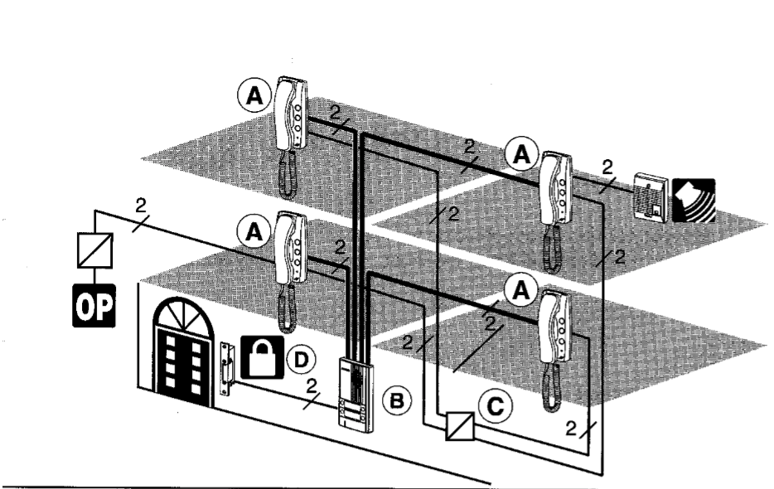
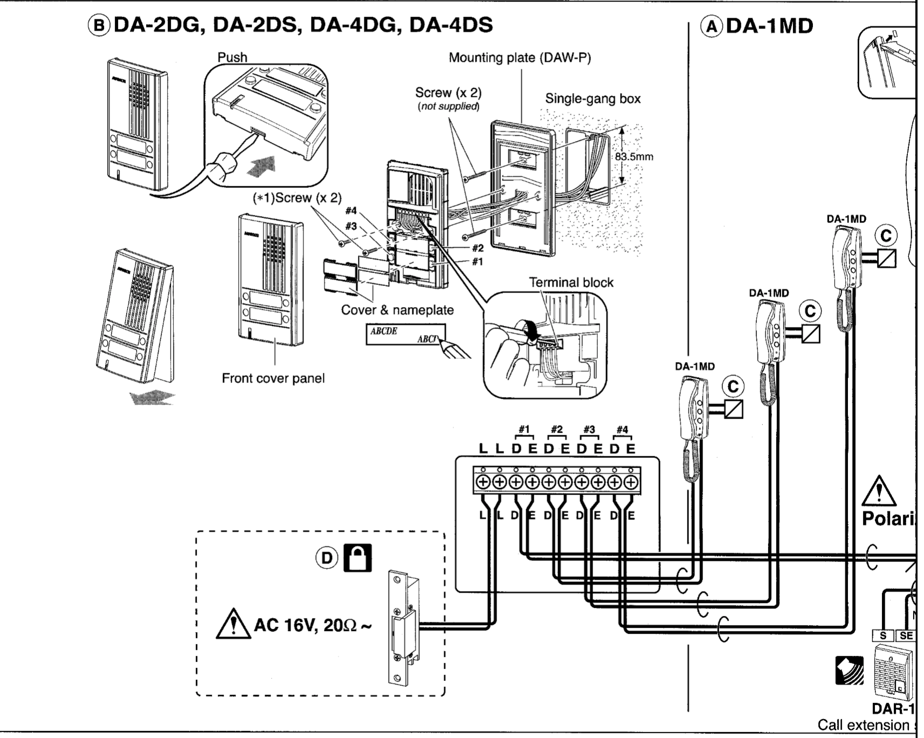
Tinkering

Slide 14



Limitations
DEMO

Slide 15

Get Creative

Slide 16

Does Anyone Have Experience?

Slide 17
IBM Watson

Slide 18
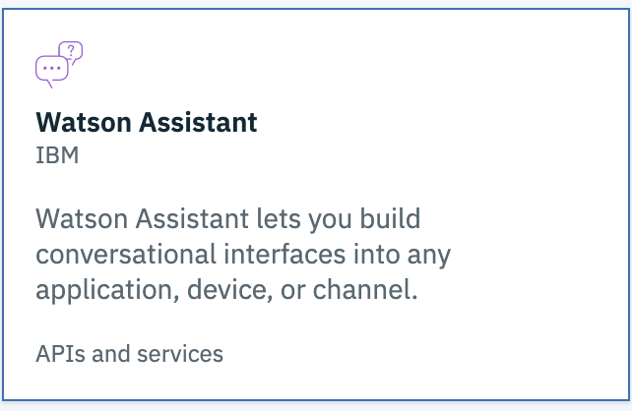
Watson Assistant
DEMO

Slide 19
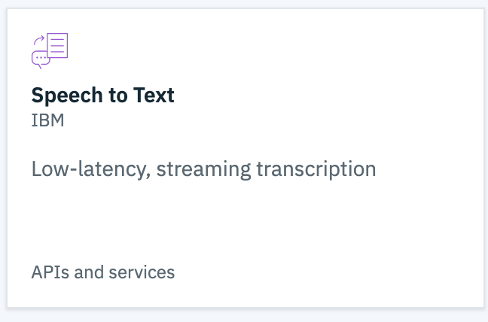
Watson Speech-to-Text
DEMO

Slide 20
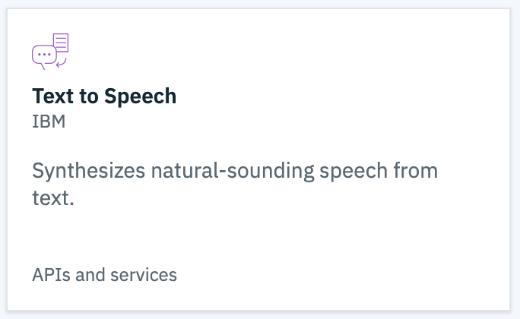
Watson Text-to-speech
DEMO

Slide 21
Environment

Slide 22
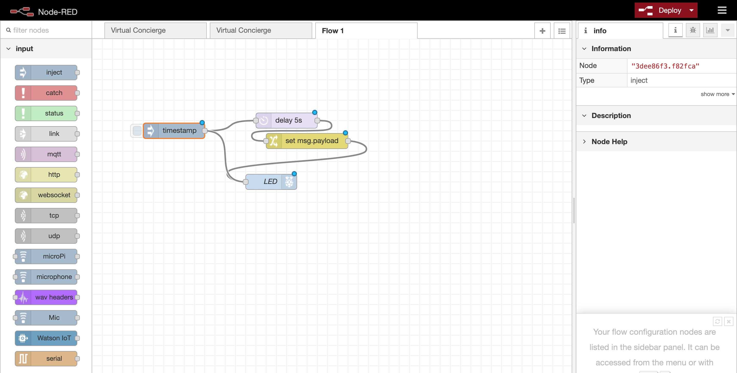

Slide 23
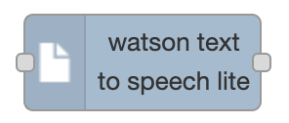


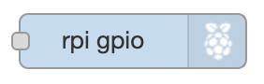



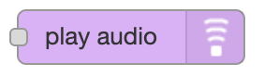


Different Nodes

Slide 24
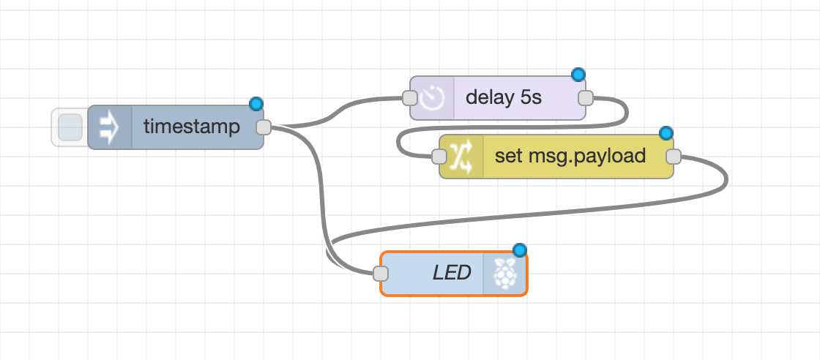
Flows

Slide 25
Side Bar

Slide 26
Info/Debugging Window

Slide 27
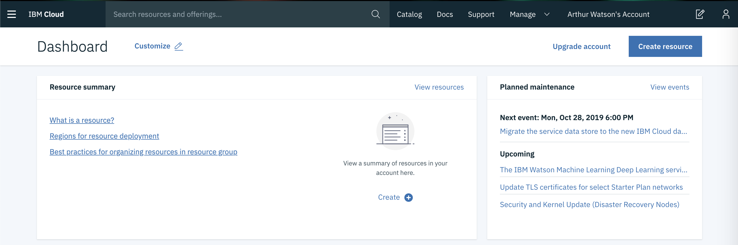
Ibm Cloud

Slide 28
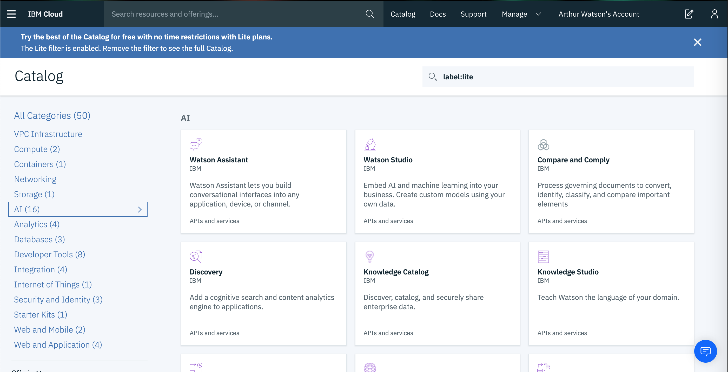

Slide 29
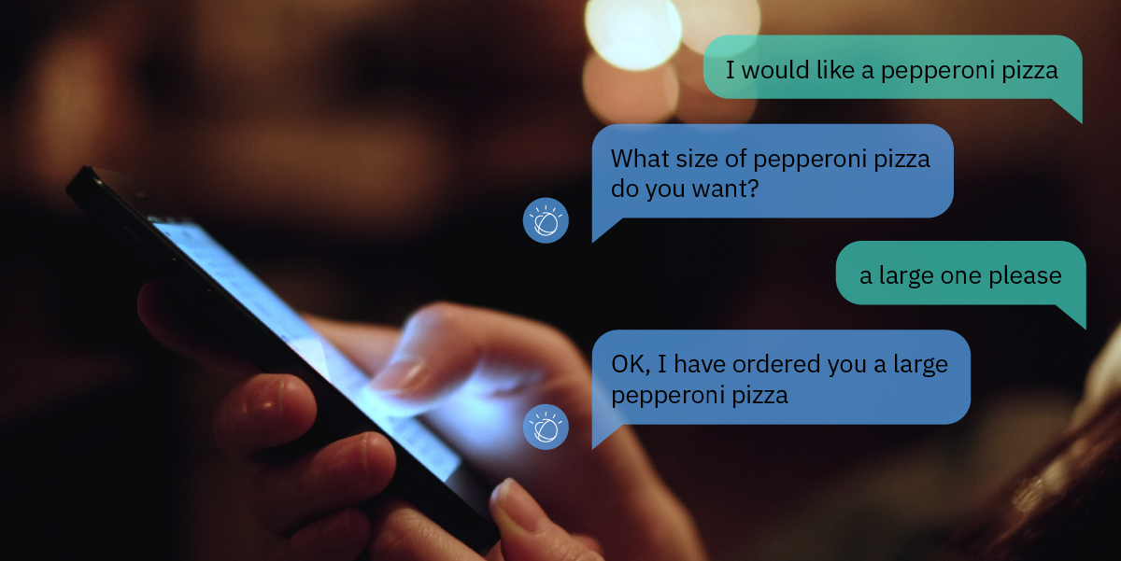
Making a chatbot

Slide 30
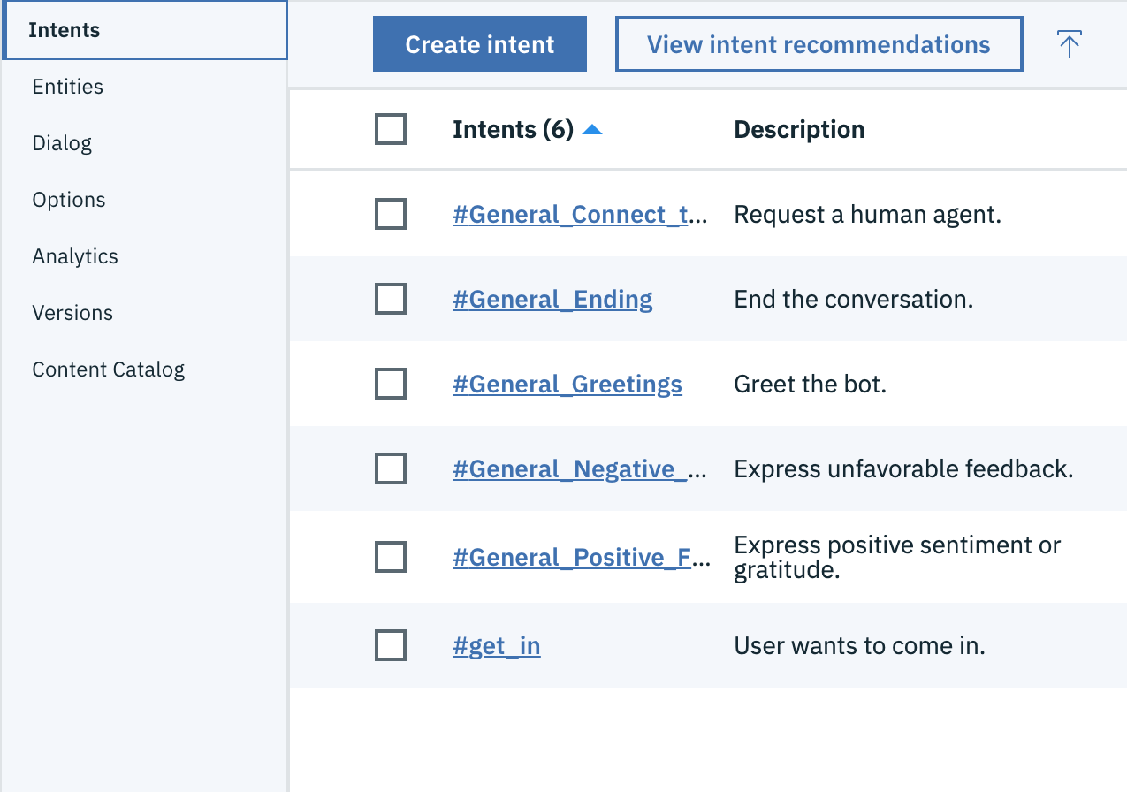
Intent
Intents are purposes or goals that are expressed in a customer's input

Slide 31
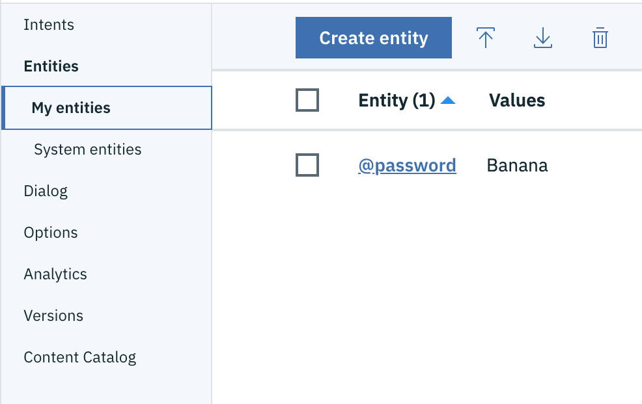
Entity
Looks for a Specific word the user said to Watson

Slide 32
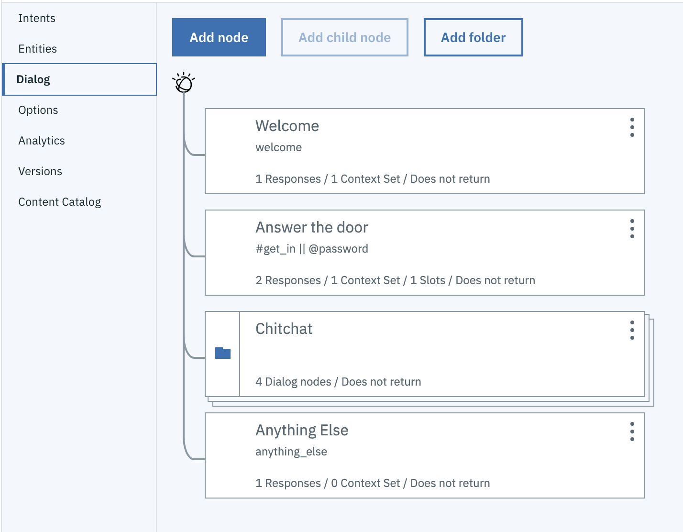
Dialog
The dialog uses the intents, entities, and context to provide feedback to the user

Slide 33
RECAp

Slide 34
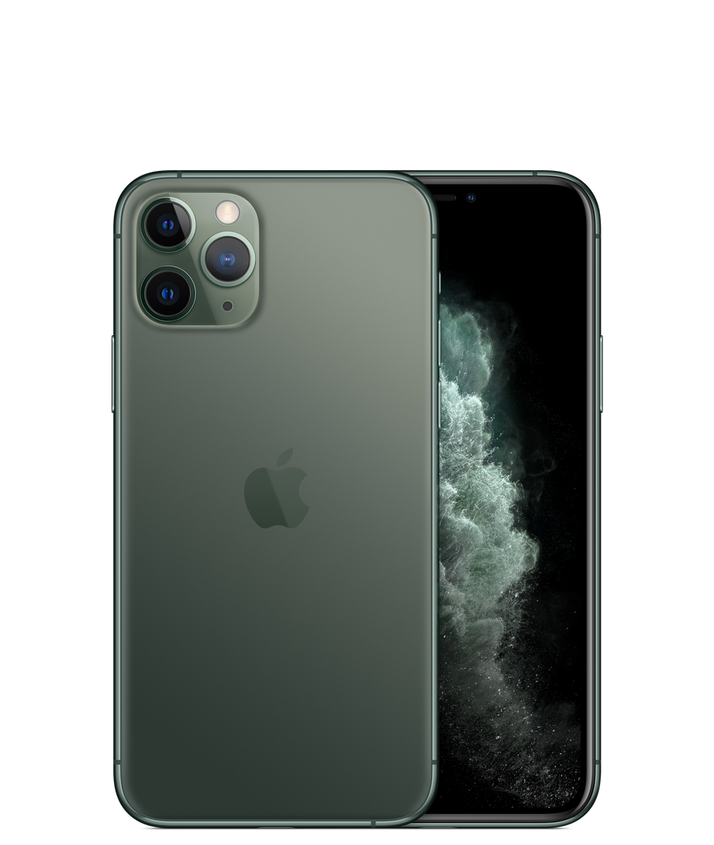



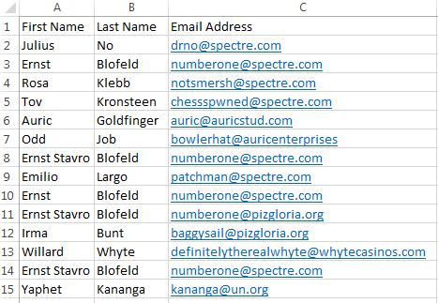
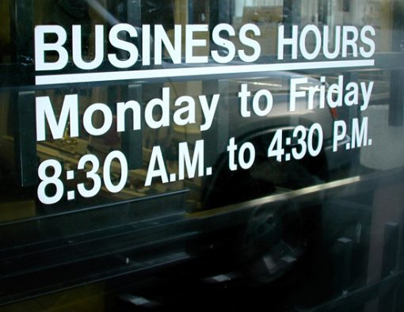
Other Ideas
Ask if open, or set a do not disturb.

Slide 35
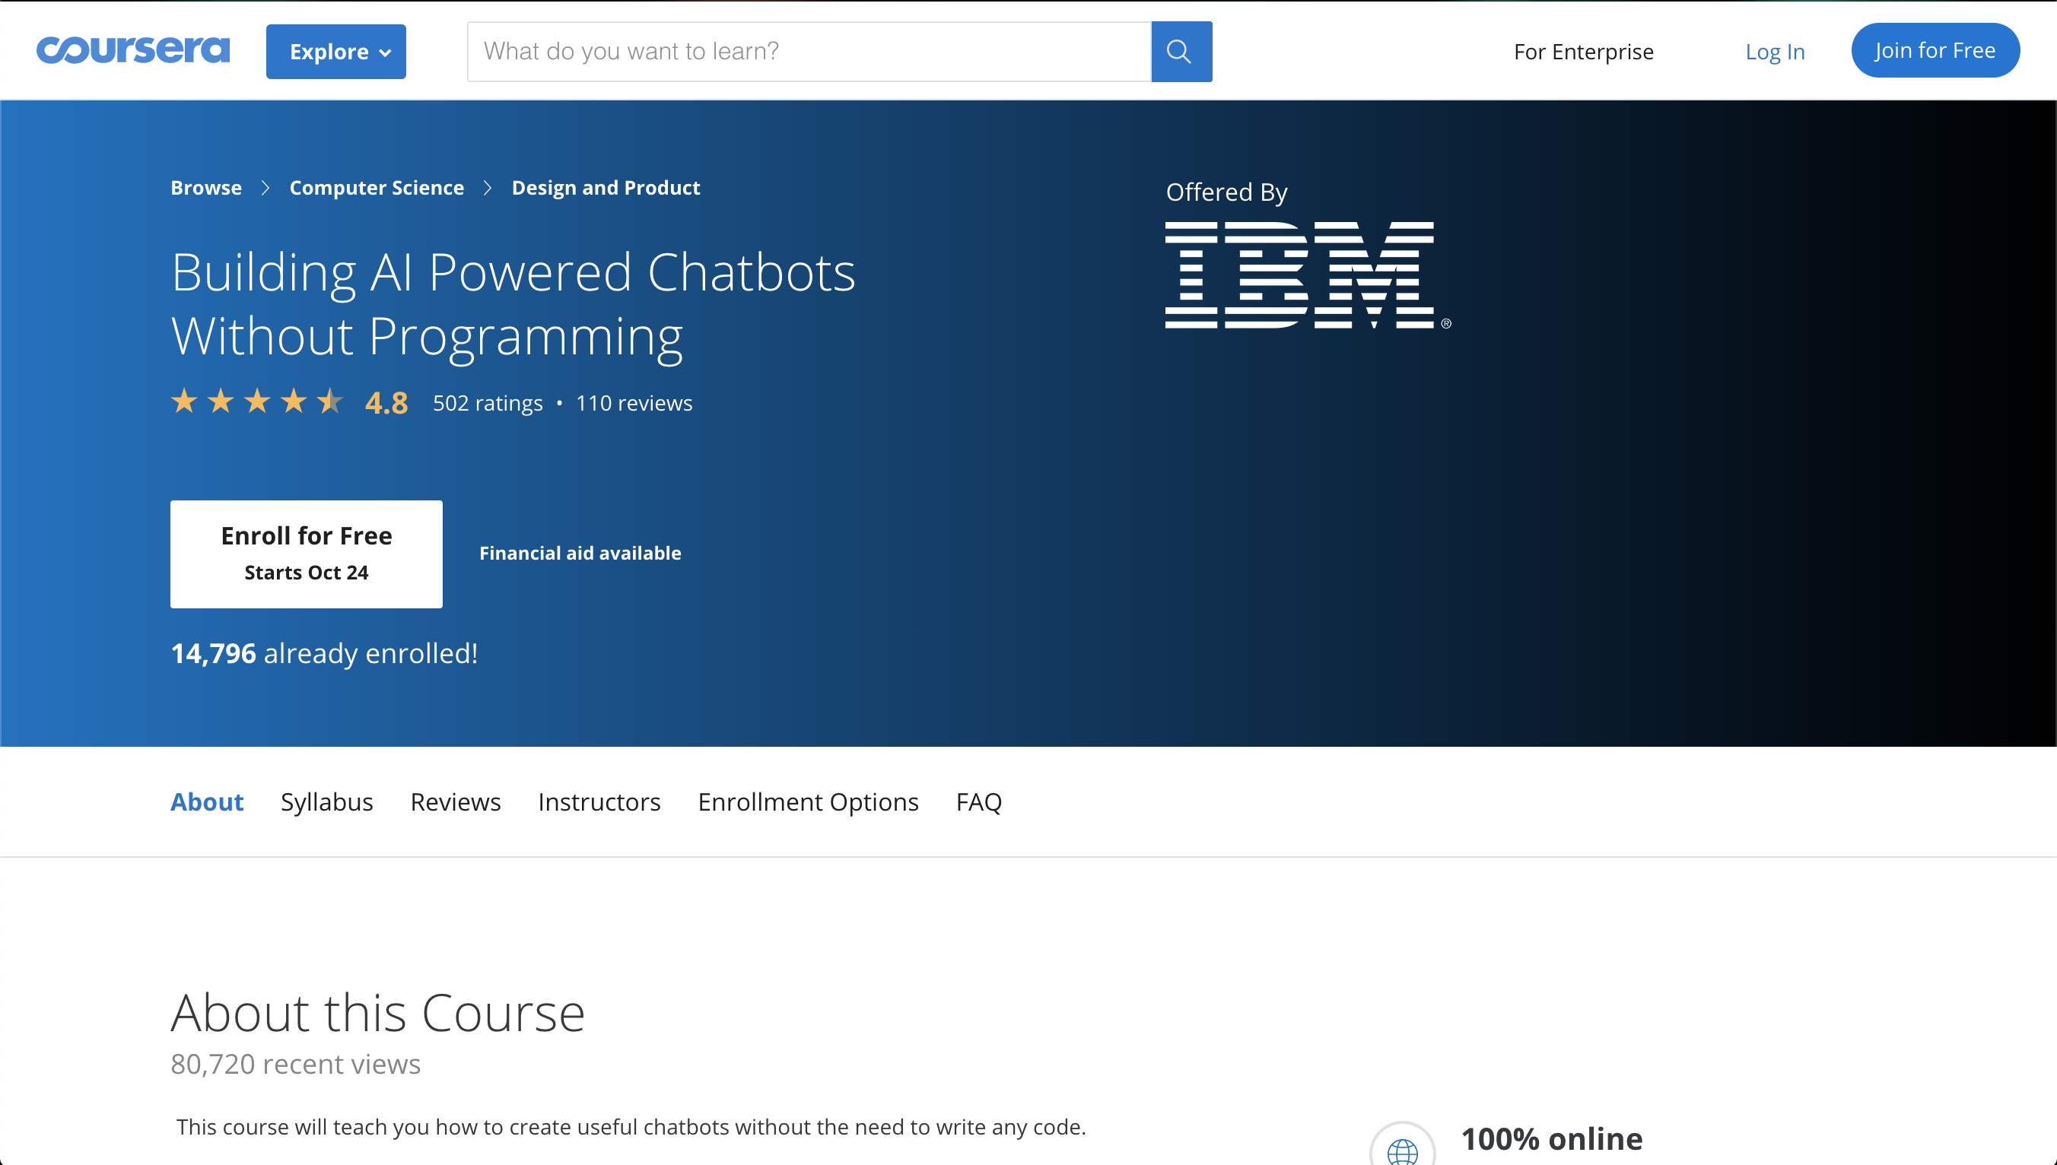

Slide 36
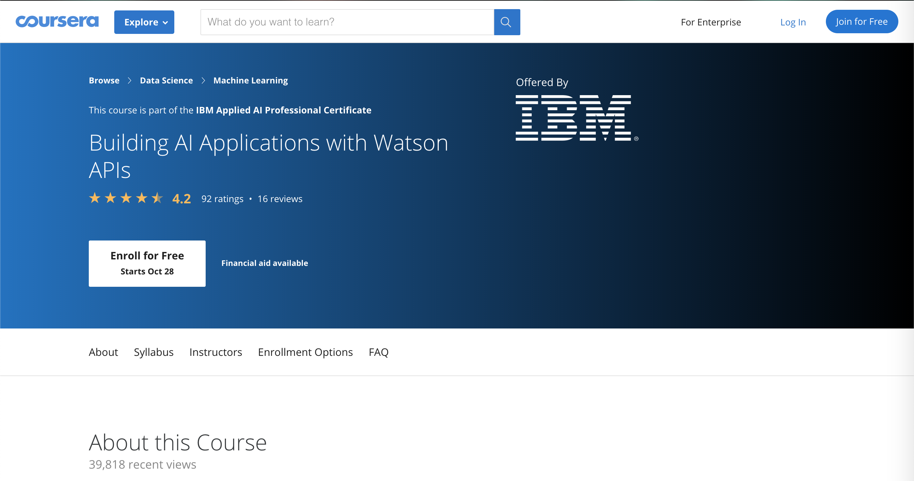
Other Resources

Slide 37


Slide 38
Contact Us
Eric Quan
Matthew Grech
https://www.linkedin.com/in/shengxu-quan1/
shengxu@ibm.com
https://www.linkedin.com/in/matthew-grech-6b6a56162/
mgrech@ibm.com

